Slide 1

Dashboard Project
Created by : Anindita Nath
Supervisor: Dr. Chalil Madathil, Sreenath
University of Texas at El Paso
CARES ACT FUNDING: ECONOMIC RESPONSE + RECOVERY
CITY OF EL PASO ECONOMIC & INTERNATIONAL DEVELOPMENT

Slide 2

Objectives
Build a dashboard tracking local businesses demands and needs for products required during COVID19.
Help El Paso city’s manufacturing companies asses and alleviate business
Project Requirements
interactive Dashboard
real-time update
access to local businesses to update their needs
filter according to product categories
include geo-spatial mapping for locating manufacturing companies for each category
Software Tools
To create: Tableau desktop-student 1 year free, connect to MS Access, Excel, .CSV, etc. hosting easy, after 1 year, $70 per month per user to purchase
To host : Tableau Server or Online : Creator, Explorer and Viewer licenses
CARES ACT FUNDING: ECONOMIC RESPONSE + RECOVERY
CITY OF EL PASO ECONOMIC & INTERNATIONAL DEVELOPMENT

Slide 3
Scope of our project
Includes supplier details of local manufacturing industries in El Paso:
Suppliers include not only PPEs and other COVID19 critical suppliers but also other manufacturing industries
Available PPE database (EPCOVID19.org) can be merged with ours
Contact details: address, zip, phone, url, email.
Accurate geospatial mapping
Annual revenue
Manufacturing qty.
Supply per month qty
Multiple filters: product category, product type, zip-code, sort by demand quantity, sort by supply quantity
Partial access to local businesses to update their monthly requirements data (PPE, Critical, non-critical)
Can be embedded in multiple websites
CARES ACT FUNDING: ECONOMIC RESPONSE + RECOVERY
CITY OF EL PASO ECONOMIC & INTERNATIONAL DEVELOPMENT

Slide 4
Data Provider -TMAC
http://tmac.utep.edu/
CARES ACT FUNDING: ECONOMIC RESPONSE + RECOVERY
CITY OF EL PASO ECONOMIC & INTERNATIONAL DEVELOPMENT

Slide 5
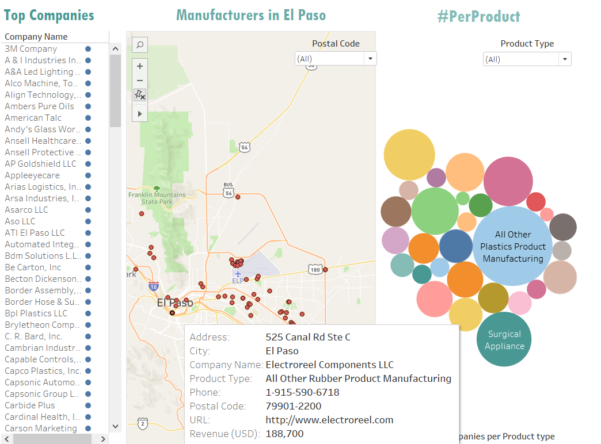
Prototype Dashboard
CARES ACT FUNDING: ECONOMIC RESPONSE + RECOVERY
CITY OF EL PASO ECONOMIC & INTERNATIONAL DEVELOPMENT

Slide 6
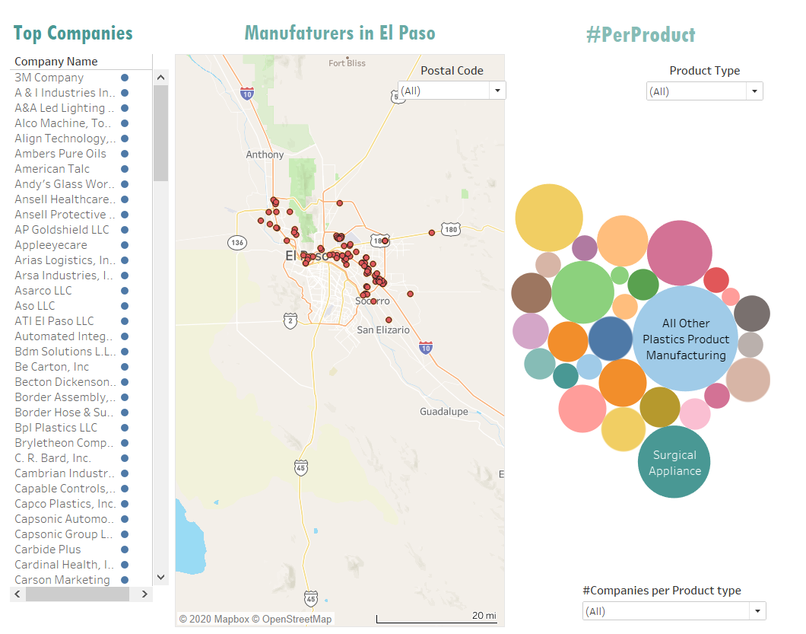
Prototype Dashboard
CARES ACT FUNDING: ECONOMIC RESPONSE + RECOVERY
CITY OF EL PASO ECONOMIC & INTERNATIONAL DEVELOPMENT

Slide 7
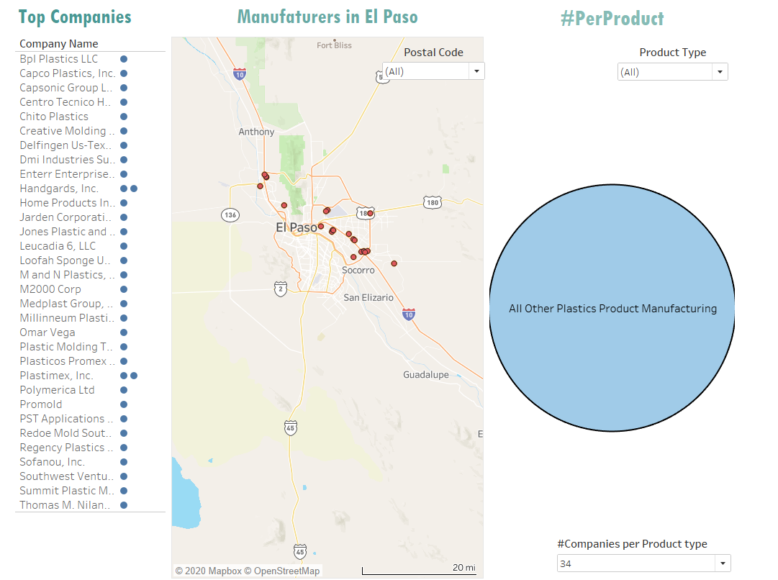
Prototype Dashboard
CARES ACT FUNDING: ECONOMIC RESPONSE + RECOVERY
CITY OF EL PASO ECONOMIC & INTERNATIONAL DEVELOPMENT

Slide 8
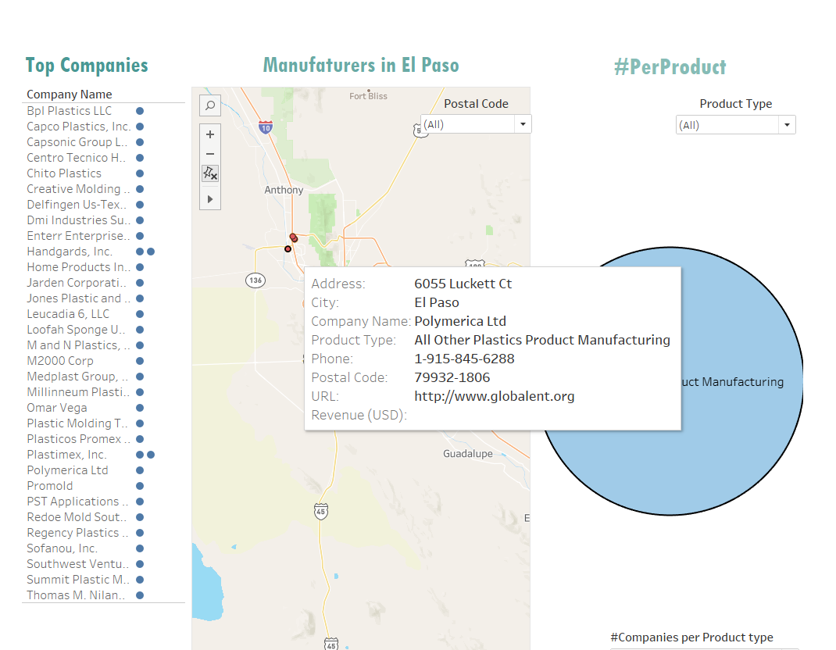
Prototype Dashboard
CARES ACT FUNDING: ECONOMIC RESPONSE + RECOVERY
CITY OF EL PASO ECONOMIC & INTERNATIONAL DEVELOPMENT

Slide 9
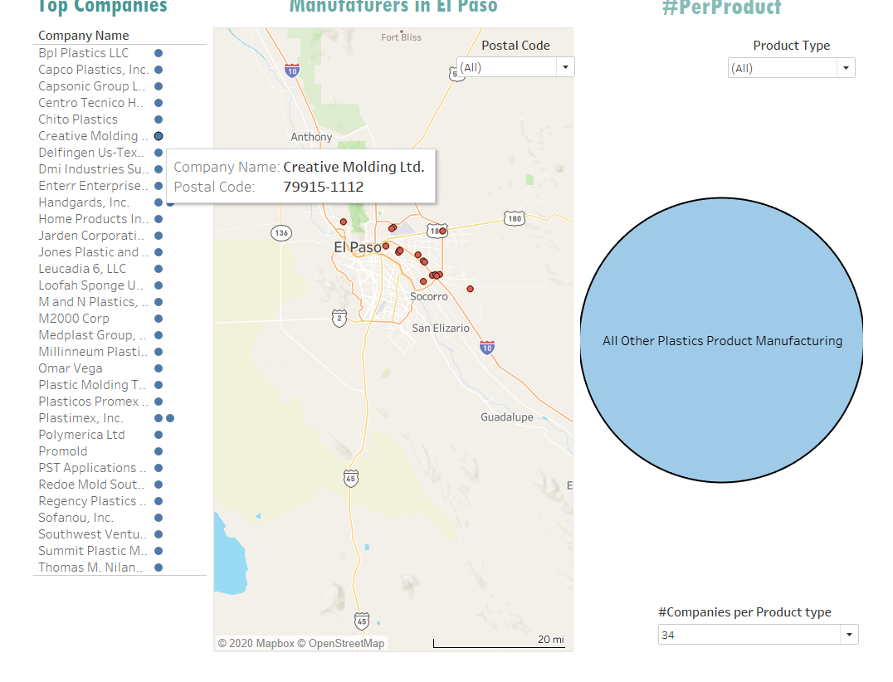
Prototype Dashboard
CARES ACT FUNDING: ECONOMIC RESPONSE + RECOVERY
CITY OF EL PASO ECONOMIC & INTERNATIONAL DEVELOPMENT

